Slide 1
Robotics Project
Created By :Joe V, Ryan T, Emilia B

Slide 2
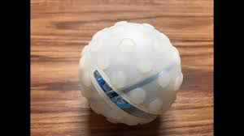
Challenges we have faced
One of the main challenges we faced was being able to keep consistency after each trial. The protective rubber shell made the robot move in unexpected directions sometimes making it very difficult to get results.
Another Small problem that we faced was finding time to get work done together since we all had filled schedules between work and practice.

Slide 3

Roles Of Each Member
Ryan made most of the code because he had the most experience and was most comfortable with that aspect of the project.
Emilia was the one who would make out flowcharts and algorithms
Joe would put everything onto the design document and make the task lists and the Test Plans

Slide 4

What have we learned?
So far we have learned that software engineering is not just sitting down and writing code, but actually that there are many different moving parts that go into a product. And that not everything is on the computer, there is a lot more thinking and problem solving in your head that you have to be able to do to become a good software engineer.

Slide 5
What would we do differently?
We believe that instead of using code from an app, that we should make a game on Python game. Instead of having three different sprints we could be assigned to design three different levels of the game.
The problem with the Sphero device was that we felt that we were not actually writing code but actually just playing with a kids toy.

Slide 6
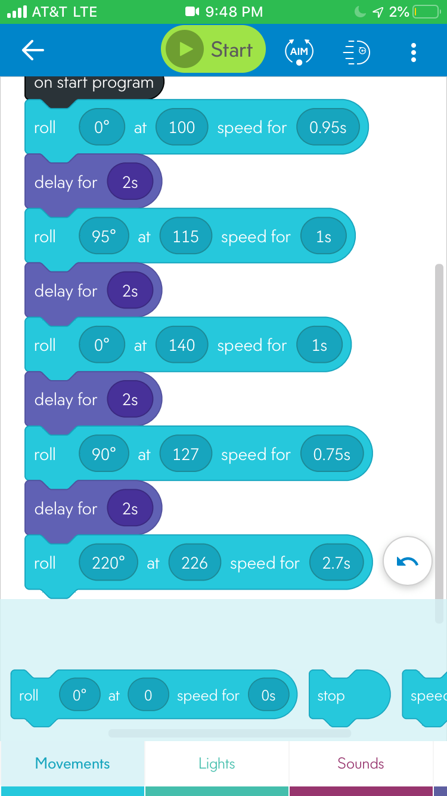
Our Code

